Slide 1


ALY 6000​ Module 6 Project 6
Final Project Report
Sunil Raj THOTA NUID: 001099670

Slide 2
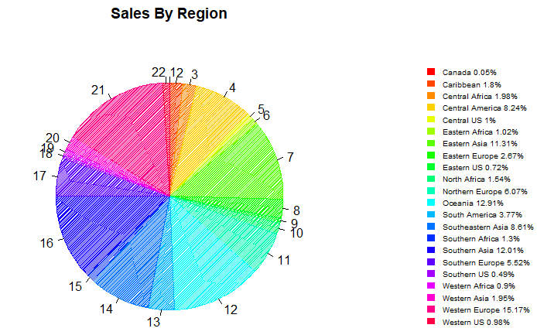
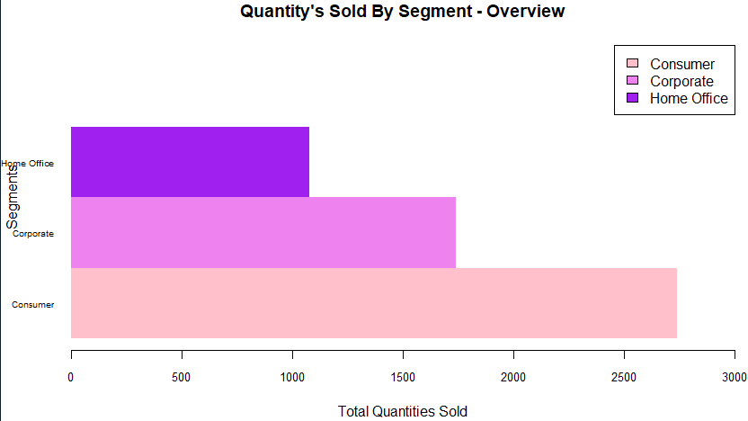
I have calculated the percentages of Sales by Region to analyze where it is doing well and got to observe that it’s doing great in Eastern Asia, Central America, Oceania, Southern Asia, South-eastern Asia making around 50% of the sales.
The above chart depicts that the number of quantities sold by various Segments like Home Office, Corporate, and Consumer. We can see that the Consumer Segment alone sold 70% of the Products.

Slide 3
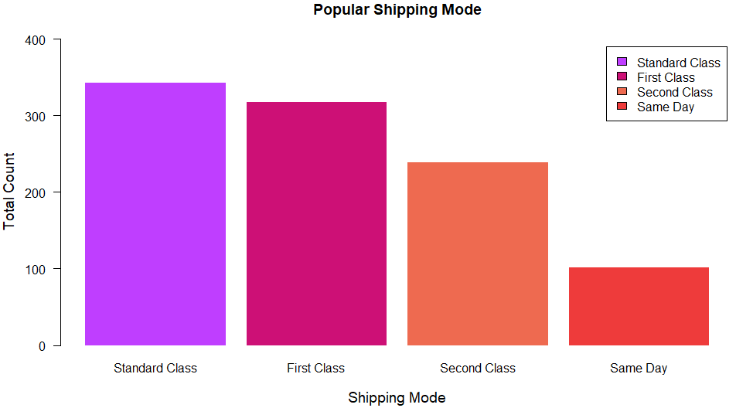
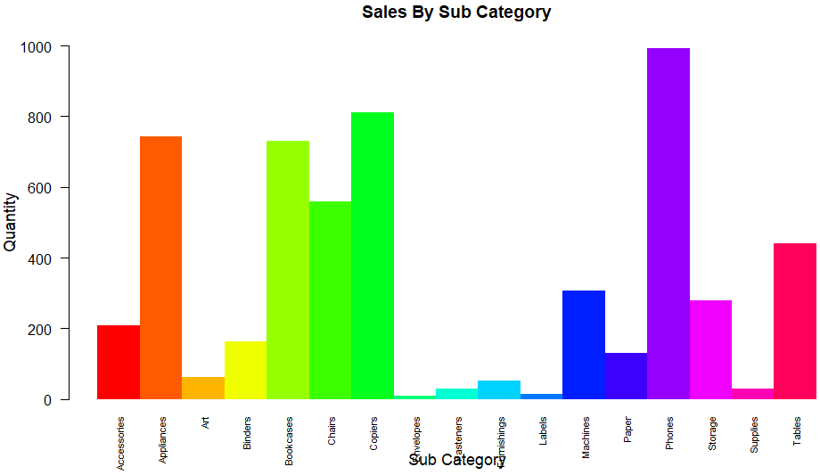
So, with this data one can utilize
What to sell?
How many quantities sold and when needs to be refilled in the inventory to pile up the stocks so that customers can come back?
How to market properly and find the target audience?
What Customers do require is necessary to know!!

Slide 4
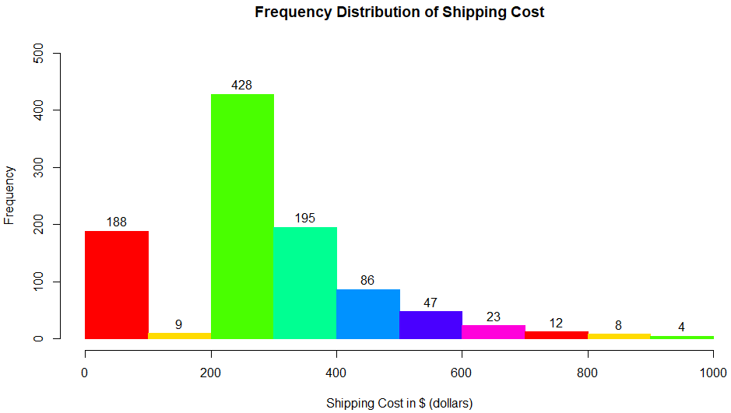
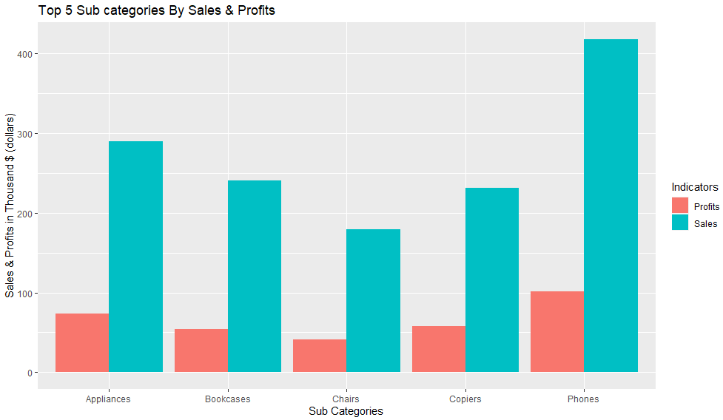
One can observe that the 42% of the orders have shipping cost from 200$ to 300$ and 38% of orders have 0 to 100$ and 300 to 400$.
This showcases Phones, Appliances, and Bookcases are the top 3 Sub categories in Sales and their Profits. They account around 750+ products in sales and profits from them which is huge in a particular segment and market.

Slide 5
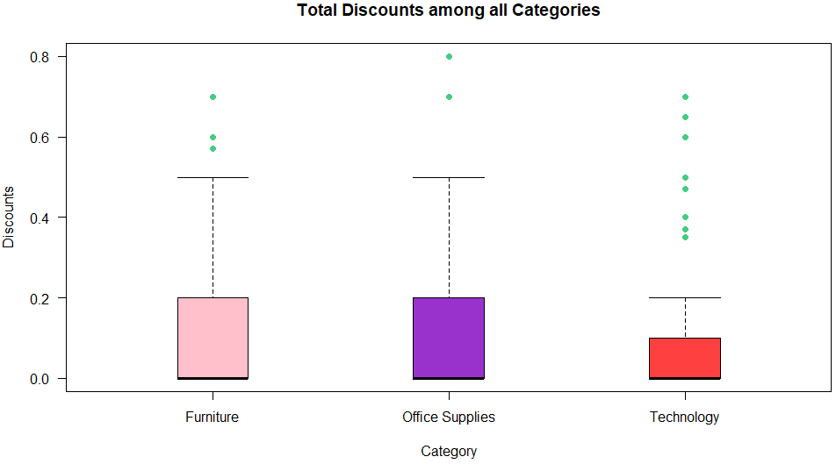
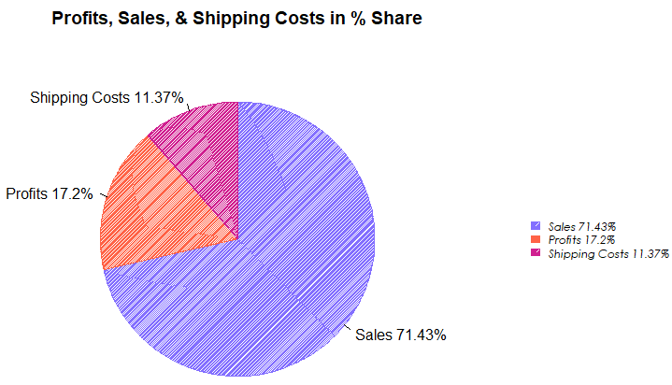
This chart shows that the Discounts offered among all the categories and in which Office Supplies and Furniture offered more than the twice of what Technology has offered.
Here, I have calculated the Overall Market Share in terms of Revenue and Sales. I observed and analyzed that the company is getting most i.e., 70% its revenue from its direct sales and the rest is taken care by profits and shipping costs.

Slide 7
Conclusion
With the help of huge data collection from the customers the companies are planning to implement few advanced ways of buying their products.
The big data revolution is going to set new standards and will become the future of any industries.
The use of statistics and visualization in the fields of Data Analytics and its related networks are unprecedently becoming the go to word for all the businesses and companies.
An efficient supply chain, an enhanced drive of goods from dealers to silos to stores to the shopper, is very serious in every business.
So, big data analytics is so essential of transforming the industry and excels in real-time, leveraging customer data to envisage purchasing forms.
These charts helps a person to understand better and clear about the insights drawn from the data Excel and R are one of basic building blocks to start with and also these tools are in high in demand

